Slide 1


A Public Repository of python resources
Subtitle
Notes:
NOTE:
To change the image on this slide, select the picture and delete it. Then click the Pictures icon in the placeholder to insert your own image.

Slide 2
Abstract
This presentation will be of a slightly different format than our usual student seminars. Instead of being a presentation on my specific research, it will be a presentation regarding the resources available for learning python. Before coming to BU, I had never used python. As I learned more about programming, I came to appreciate the utility of python and began seriously studying the language.
Python is a robust and highly popular open source programming language. As result, there is a wealth of resources available. However, the vastness of information can make it difficult to know where to start, or how to know which resources are the most worthwhile. The motivation behind this presentation is to help others learn python, or become aware of resources they may otherwise have not known about. This presentation will cover some general coding and python basics, the most important best practices to be aware of, important python libraries for astronomy, and, most importantly, a repository of some of the best resources I have found for python and coding in general.

Slide 3

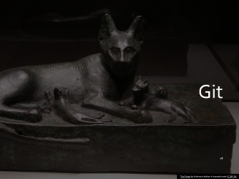
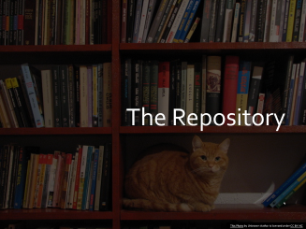
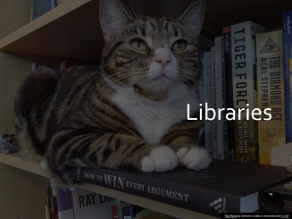
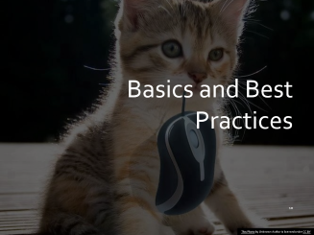

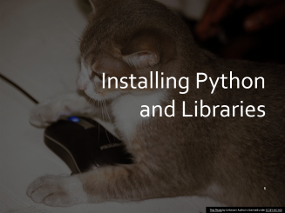

Outline

Slide 4
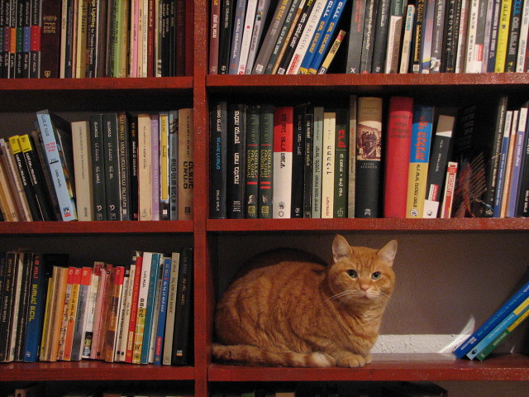
The Repository
This Photo by Unknown Author is licensed under CC BY-NC

Slide 5
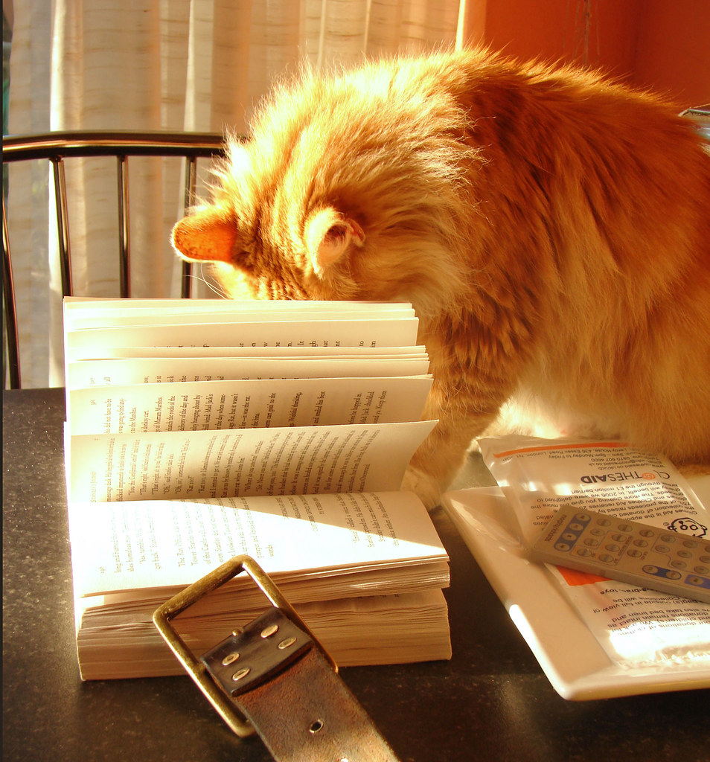
The Repository
GitHub
Open for collaboration
https://github.com/mhallum/important-python-resources.git
This Photo by Unknown Author is licensed under CC BY

Slide 6
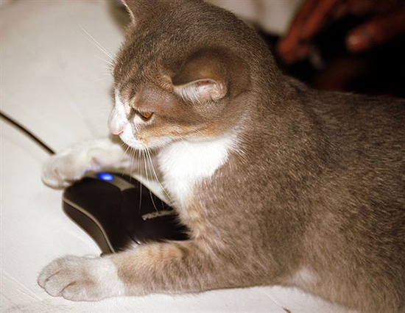
Installing Python and Libraries
This Photo by Unknown Author is licensed under CC BY-NC-ND

Slide 7
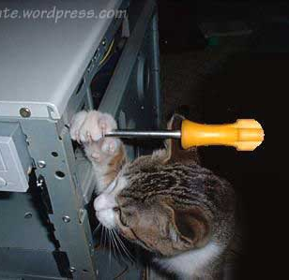
Installing Python and Libraries
Python 2 vs. Python 3
Python 3!
Website: https://www.python.org/
PyPi
Pip
This Photo by Unknown Author is licensed under CC BY-NC-ND

Slide 8
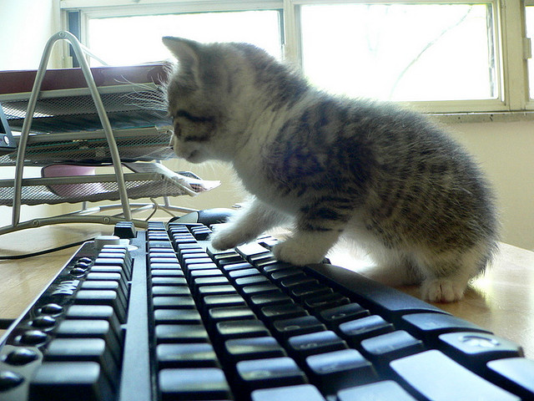
Editors
This Photo by Unknown Author is licensed under CC BY-SA

Slide 9
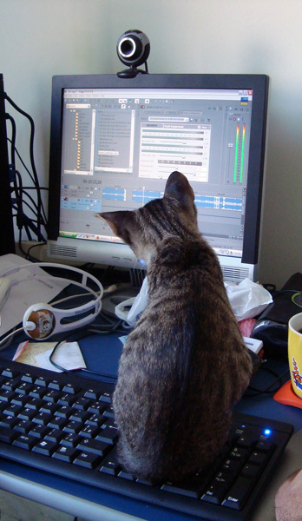
Editors
Visual Studio Code
Atom
Jypyter Notebook
Pycharm
Spyder
Default
This Photo by Unknown Author is licensed under CC BY-NC-ND

Slide 10
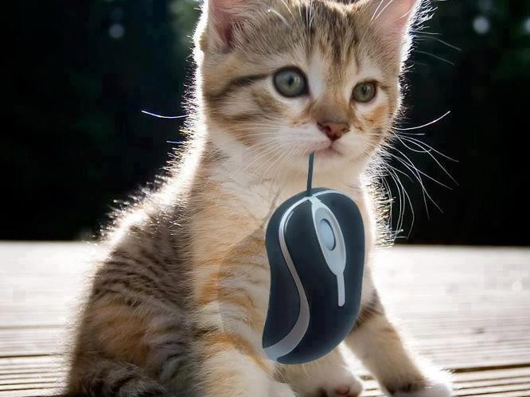
Basics and Best Practices
This Photo by Unknown Author is licensed under CC BY

Slide 11

Basics
Objects
Print
comments
dir
help
Modules
Packages
https://github.com/astropy/astropy
dunder
This Photo by Unknown Author is licensed under CC BY

Slide 12
Best Practices
Pep 8 https://www.python.org/dev/peps/pep-0008/
4 spaces
Variables and functions are lower case with _ for joining multiple words.
Classes are CamelCase (but instances are lowercase).
Private variables/functions/ect., begin with _.
Use virtual environments
This Photo by Unknown Author is licensed under CC BY

Slide 13
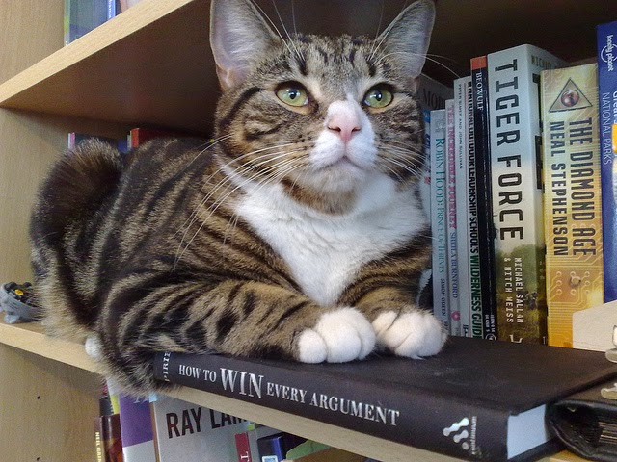
Libraries
This Photo by Unknown Author is licensed under CC BY

Slide 14
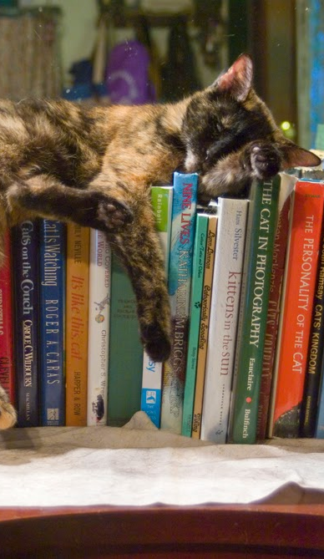
Standard
os
pathlib
glob
pickle
argparse
datetime
math
statistics
This Photo by Unknown Author is licensed under CC BY

Slide 15
Third Party
matplotlib
pandas
numpy
scipy
astropy https://www.astropy.org/
ccdproc
specutils
This Photo by Unknown Author is licensed under CC BY

Slide 16
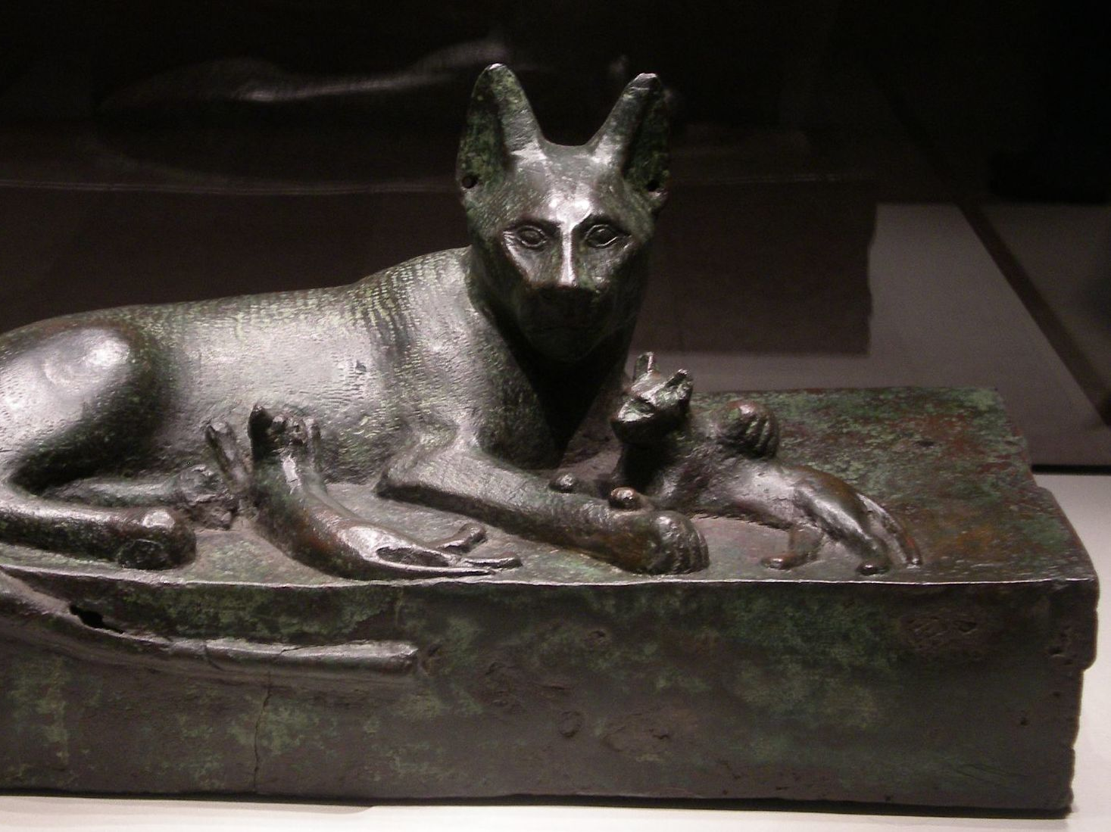
Git
This Photo by Unknown Author is licensed under CC BY-SA

Slide 17
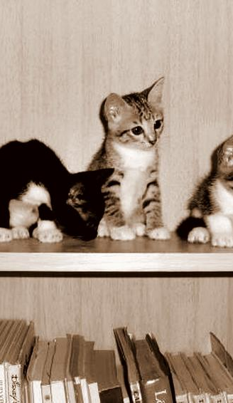
Git
Version control.
https://git-scm.com/
Stage
Commit
Push
This Photo by Unknown Author is licensed under CC BY-SA

Slide 18
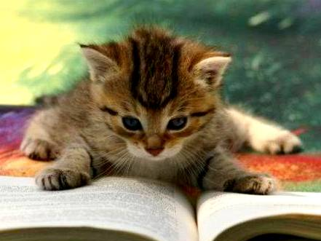
Resources
This Photo by Unknown Author is licensed under CC BY

Slide 19
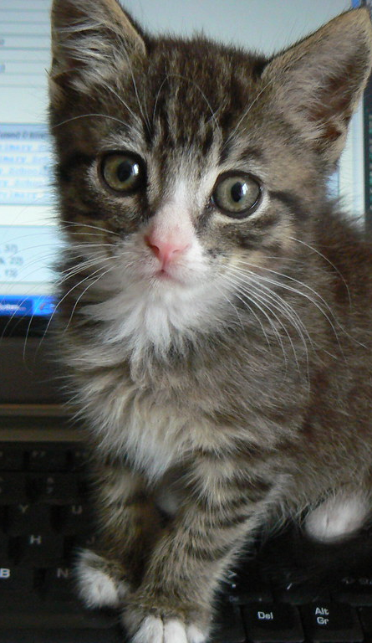
Resources
Previously referenced websites
Real Python https://realpython.com/
Medium https://medium.com/
YouTube
Udemy Courses https://www.udemy.com/
Wait for sales.
This Photo by Unknown Author is licensed under CC BY

Slide 20
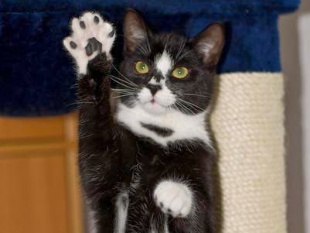
Questions?
This Photo by Unknown Author is licensed under CC BY-NC

